Slide 1
Tree in Data Structure
Week 12

Slide 2
Outline
Linear vs Non-Linear Data Structures
Introduction to Tree Data Structure
Trees – terminologies
Trees –Applications
Binary Tree ADT
Representation of Binary Tree
Types of Binary Trees
Binary Search Tree (introduction, insertion and deletion)

Slide 3
Data Structures – categories
Linear Data Structures
The data is arranged in a linear form
Array, Linked List, Queue and Stack
Non-linear Data Structures
Data is in the form of hierarchy
Tree, Graphs

Slide 4
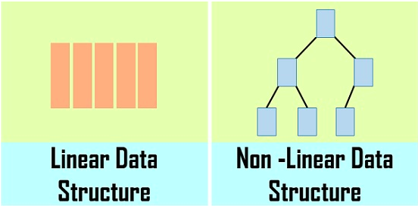
Linear vs non-linear data structures

Slide 5
Difference between Linear and non linear data structure
Linear Data Structure | Non-Linear Data Structure
Every item is related to its previous and next item. | Every item is attached with many other items.
Data is arranged in linear sequence. | Data is not arranged in sequence.
Data items can be traversed in a single run. | Data can not be traversed in a single run.
Examples: Array, Stack, Queue, Linked List. | Examples: Tree, Graph.
Implementation is Easy. | Implementation is Difficult.

Slide 6
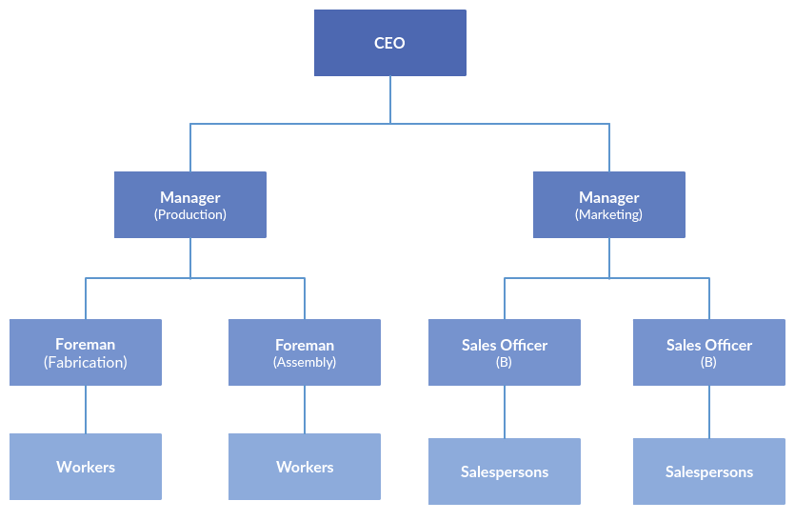
Non Linear Data Structure

Slide 7
Tree Data Structure
Tree: Tree is a collection of nodes which are linked together to stimulate a hierarchy
Direction is from top to bottom

Slide 8
Tree Data Structure – Terminologies
Root: Node having no parent
Parent Node: Immediate predecessor (pervious node) of any node is called parent of a node. We can also have grand parent, grand grand parent
Child Node: Immediate successor (next node) of any node is called parent of a node. We can also have grand child etc.
Leaf Node: having no child, also known as external node.

Slide 9
Tree Data Structure – Terminologies
Internal node: all nodes other than external nodes
Edge: link between two nodes
Path: sequence of any number of edges from source node to destination node
Ancestor: ancestor of a node is any predecessor node from root to that node
Descendant: any successor node from a node to the leaf nodes
Siblings: Having a common parent
Degree of a node: number of children of that node
Degree of a tree: maximum degree of any node in the tree

Slide 10
Tree Data Structure – Terminologies
Depth of a node: number of edges from root to that node
Height of a node: path from that node to the deepest leaf node, or number of edges in the longest path from that node to the leaf
Height of tree: is the height of root node
Level: root node is level 0, every hierarchy is the next level
Level of a tree is always equal to the depth of a tree or height of the tree
Level of a node is always equal to the depth of a node
If a tree has “n” nodes then it will always have (n-1) edges

Slide 11
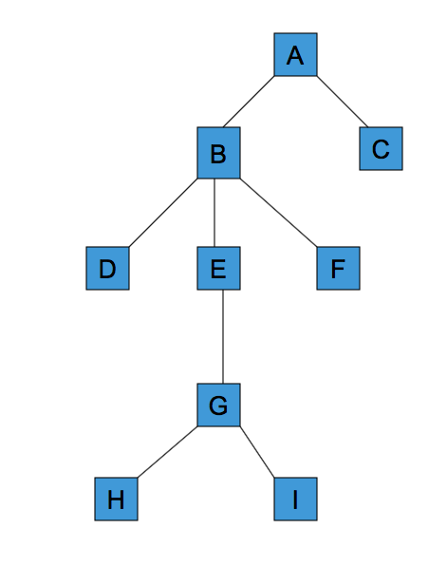
Example
Level 0
Root Node: A
Parent node of E: B
Child Node of E: G
Ancestors of E: B and A
Descendants of E: G, H, and I
Leaf Nodes: C, D, F, H and I
Siblings of E: D and F
Degree of B: 3
Degree of this Tree: 3
Height of G: 1
Depth of G: 3
Level 1
Level 2
Level 3
Level 4

Slide 12
Activity (unmarked)
Root Node:
Parent node of G:
Child Node of H:
Ancestors of E:
Descendants of C:
Leaf Nodes:
Siblings of B:
Degree of D:
Degree of this Tree:
Height of E:
Depth of E:

Slide 13
Application of tree data structure
Trees and their variants are an extremely useful data structure with lots of practical applications.
Binary Search Trees(BSTs) are used to quickly check whether an element is present in a set or not.
Heap is a kind of tree that is used for heap sort.
A modified version of tree called Tries is used in modern routers to store routing information.
Most popular databases use B-Trees and T-Trees, which are variants of the tree structure we learned above to store their data
Compilers use a syntax tree to validate the syntax of every program you write.

Slide 14
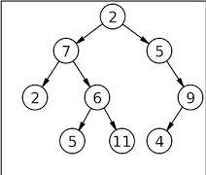
Binary Tree
a binary tree is a tree data structure in which each node has at most two children, which are referred to as the left child and the right child.

Slide 15
Representation of a Binary Tree
A binary tree is made of nodes, where each node contains a left pointer, a right pointer, and a data element. The root pointer points to the topmost node in the tree. The left and right pointers recursively point to smaller subtrees on either side.
struct node{
int data;
node *left, *right;
};

Slide 16
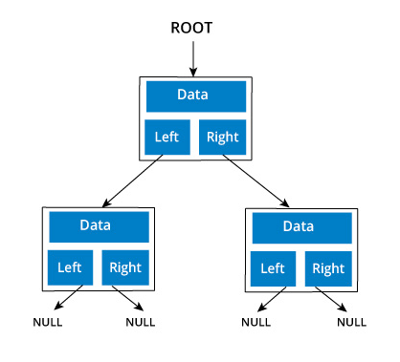
Logical Representation of Binary Tree

Slide 17
Logical Representation of Binary Tree
2
7
5
NULL
6
And so on……
Draw the complete representation on your notebooks

Slide 18
Binary Tree
Max number of nodes possible at any level is 2^{i}
Max number of nodes of a tree with height h:
2⁰ +2¹ +2² +2^{3…….} +2^{h} =>(2^{h+1} -1)(GP series)
Min number of nodes at height h = h+1

Slide 19
Types of Binary Tree
Full Binary Tree
Each node has 0 or 2 children
Number of leaf nodes = no. of internal nodes +1
Complete Binary Tree:
All the levels are completely filled, except last level. Last level has nodes as left as possible, i-e., at the last level fill nodes from left to right.
Perfect Binary Tree
All internal nodes have 2 children and all leaves are at the same level
Every perfect binary tree is also a full binary tree and a complete binary tree
Degenerate Binary Tree
All internal nodes have only one child, can be left skewed, right skewed or a mixture of both

Slide 20
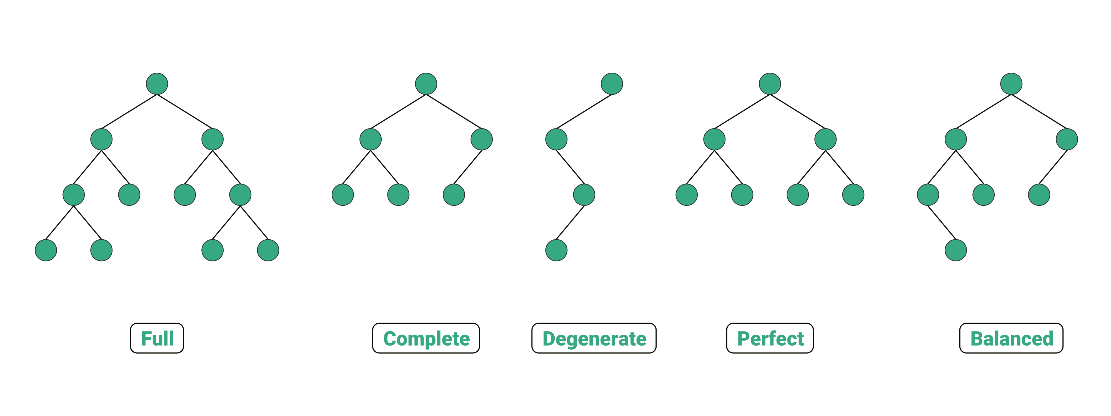
Types of Binary tree
Notes:
A balanced binary tree, also referred to as a height-balanced binary tree, is defined as a binary tree in which the height of the left and right subtree of any node differ by not more than 1.

Slide 21
Binary Search Tree
It is a Binary tree with the following conditions:
The left subtree of any node has data less than the node, and
The right subtree of any node has data greater than the node
Insertion in binary search tree:
Draw Binary search tree by adding the following numbers from left to right
11, 6, 8, 19, 4, 10, 5, 17, 43, 49, 31

Slide 22
Thank You

